Slide 1

Cloud Security Risk in the Software & Cloud Services Industry
A Socio-Technical Investigation into Shadow APIs
Fabian Narel
ID: 12697137 | Module: RMPP_PCOM7E

Slide 2



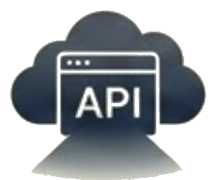
Significance & Research Problem
Economic Scale:
Global cloud spending is forecast to reach $723.4 billion by 2025 (Gartner, 2024).
The Conflict:
A "Compliance Gap" exists between rigid security standards and Agile velocity (Mircea, 2019).
The Instability:
Despite investment, 57% of organizations reported an API-related data breach within the last two years (Traceable AI, 2025).
The Consequence:
This tension drives developers to create "Shadow APIs"—undocumented interfaces that bypass security controls (Akamai, 2025).

Slide 3


Research Question
How do conflicting pressures for deployment velocity versus security compliance influence the creation of ‘Shadow APIs’ in cloud-native software teams?
Sub-Question 1
Sub-Question 2
To what extent does the "Shift Left" paradigm reduce the latency friction that leads to security workarounds?
Can a socio-technical governance framework align Zero Trust principles with Agile delivery speeds?

Slide 4






Aims & Objectives
Aim: To develop a Socio-Technical API Governance Framework that minimizes the friction between developer velocity and security protocols.
1. Quantify
2. Investigate
3. Operationalize
Quantify the prevalence of security protocol circumvention in DevOps environments using survey data.
Investigate the qualitative drivers (e.g., alert fatigue, deadline pressure) leading to Shadow APIs.
Operationalize ethical principles from the Menlo Report (Finn and Shilton, 2023) into automated workflows.

Slide 5



Key Literature Themes
Shared Responsibility
The "Shadow" Ecosystem
Misunderstandings of the boundary between IaaS and SaaS responsibilities lead to significant coverage gaps and misconfiguration (Cloud Security Alliance, 2025).
APIs are the primary attack vector, with AI-driven attacks increasing by 33% YoY (Akamai, 2025). Traditional firewalls often fail to inspect JSON payloads (Gadani, 2024).
The Translation Gap
While ethical consensus exists, abstract principles often fail to materialize into programmable controls (Kluge Corrêa et al., 2023).

Slide 6




Methodology: Explanatory Sequential Design
Leveraging Mixed Methods to capture both scale and context (Creswell, 2022).
Phase 1: Quantitative
Phase 2: Qualitative
Phase 3: Integration
Instrument: Online Survey (n=50+)
Instrument: Interviews (n=10)
Action: Synthesis
Output: Statistical baseline of "Shadow API" frequency.
Focus: "Why bypass controls?"
Logic: Use Qual to explain Quant.
Outcome: AZTAM Framework & OPA Policy Library.
(Brace, 2013)
(Sim and Waterfield, 2019)

Slide 7
Ethical Considerations
Primary Risk: Self-incrimination. Participants may fear employment repercussions for admitting to bypassing security protocols.
Strict Anonymity
Protect employment status (Miller and Mauthner, 2012).
Informed Consent
The Menlo Report Framework
Clear communication of academic purpose.
Adherence to the principles of Beneficence (minimizing harm) and Respect for Persons (Finn and Shilton, 2023).
Legal Compliance
Data Protection Act 2018.

Slide 8
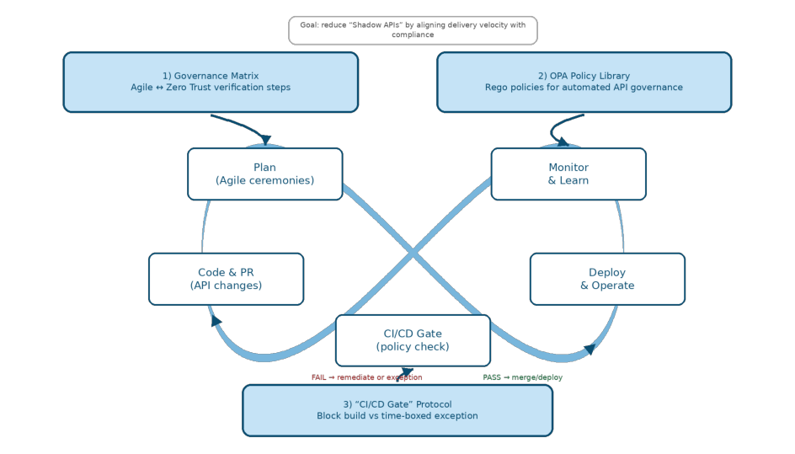
Proposed Artefact: The AZTAM System
Designed to solve the "Translation Gap" (Kluge Corrêa et al., 2023).
•
1. The Governance Matrix (Theoretical): A structured mapping of Agile ceremonies (e.g., Sprint Planning) to specific Zero Trust verification steps.
•
2. The OPA Policy Library (Technical): A GitHub repository of pre-written Open Policy Agent (OPA) scripts (Rego language) for automated API governance.
3. The "CI/CD Gate" Protocol: A decision-tree workflow that defines when to block a build (Security) vs. when to allow an exception (Agility).
•

Slide 9



Project Timeline: March - August 2026
Structured according to Project Management Body of Knowledge (PMI, 2021).
Phase 1: Inception (March - April 2026)
Phase 2: Execution (May - June 2026)
Phase 3: Synthesis (July - August 2026)
01 Mar: Submit Ethical Approval (Form A).
01 May: Deploy Survey to Forums.
01 Jul: Develop OPA Policy Scripts.
20 May: Begin Interviews (n=10).
15 Jul: Draft AZTAM Framework.
15 Mar: Recruit 5 Pilot Participants.
15 Jun: SPSS Statistical Analysis.
01 Aug: Final Dissertation Write-up.
01 Apr: Refine Zero Trust Literature.
Milestone: 30 Jun - Data Collected.
Milestone: 31 Aug - Submission.
Milestone: 30 Apr - Survey Finalized.

Slide 10
Reference List
Akamai (2025) State of Apps and API Security 2025: How AI Is Shifting the Digital Terrain. [Report]. Available at: https://mysecuritymarketplace.com/reports (Accessed: 8 December 2025).
Kaplan, B. and Maxwell, J.A. (2005) 'Qualitative Research Methods for Evaluating Computer Information Systems', in Anderson, J.G. and Aydin, C.E. (eds) Evaluating the Organizational Impact of Healthcare Information Systems. New York: Springer.
Berenson, M.L., Levine, D. and Szabat, K. (2020) Basic Business Statistics: Concepts and Applications. 14th edn. Harlow: Pearson.
Kluge Corrêa, N. et al. (2023) 'Worldwide AI ethics: A review of 200 guidelines and recommendations for AI governance', Patterns, 4(10).
Brace, I. (2013) Questionnaire design: how to plan, structure and write survey material for effective market research. London: Kogan Page.
Miller, T. and Mauthner, M.L. (2012) Ethics in Qualitative Research. London: SAGE Publications.
Cloud Security Alliance (CSA) (2025) The State of Cloud and AI Security 2025. [Report]. Available at: https://cloudsecurityalliance.org (Accessed: 8 December 2025).
Mircea, E. (2019) 'Project Management using Agile Frameworks', Economy Informatics, 19(1), pp. 34-44.
Nicholas, J.M. and Steyn, H. (2020) Project management for engineering, business and technology. 6th edn. London: Routledge.
Creswell, J.W. (2022) 1. What is Mixed Methods Research? | John W. Creswell | Mixed Methods @ University of Michigan. [Video]. Available at: https://www.youtube.com (Accessed: 8 December 2025).
Sim, J. and Waterfield, J. (2019) 'Focus Group Methodology: Some Ethical Challenges', Quality & Quantity, 53(6), pp. 3003-3022.
Finn, M. and Shilton, K. (2023) 'Ethics governance development: The case of the Menlo Report', Social Studies of Science, 53(3), pp. 325-349.
Traceable AI (2025) 2025 Global State of API Security. [Report]. Available at: https://www.traceable.ai (Accessed: 12 December 2025).
Gadani, N.N. (2024) 'Security Challenges in Cloud-Based Software Development: A DevSecOps Perspective', Journal of Scientific and Engineering Research, 11(5), pp. 287-294.
Wohlin, C. (2021) 'Case Study Research in Software Engineering—It is a Case, and it is a Study, but is it a Case Study?', Information and Software Technology, 133.
Gartner (2024) Gartner Forecasts Worldwide Public Cloud End-User Spending to Total $723 Billion in 2025. [Press Release]. 19 November. Available at: https://www.gartner.com.

